Slide 1

FRONT-END
WEB DEVELOPMENT

Slide 2


CSS3

Slide 3


What is CSS?
CSS stands for Cascading Style Sheets.
CSS can be added to HTML elements in 3 ways:
Inline - by using the style attribute in HTML elements
Internal - by using a <style> element in the <head> section
External - by using an external CSS file

Slide 4
The main format for CSS
Selector {
Property : Value ;
}
div {
background-color : blue ;
}

Slide 5

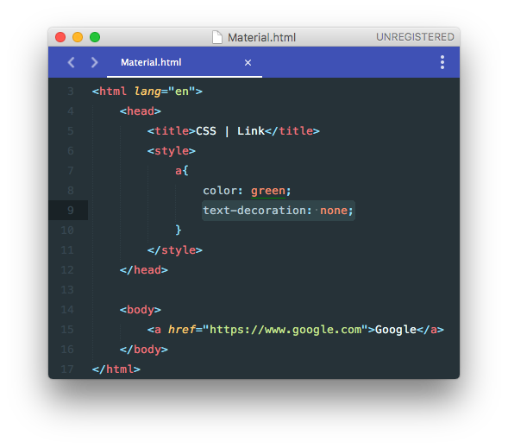
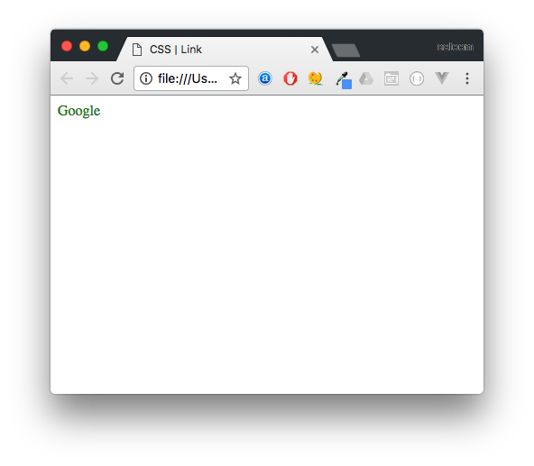
Link: no decoration

Slide 6

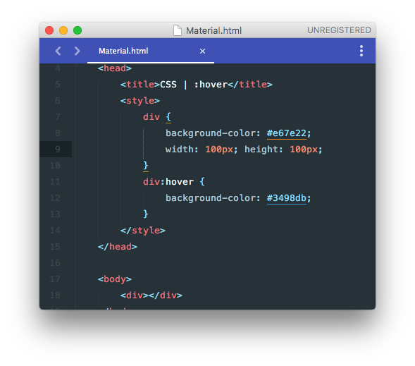
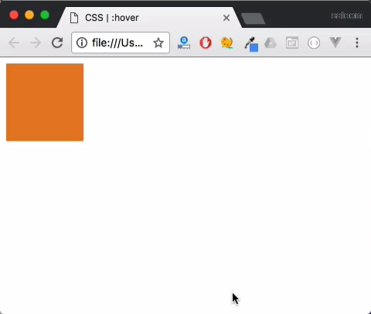
CSS :hover Selector

Slide 7
Project 5

Slide 8

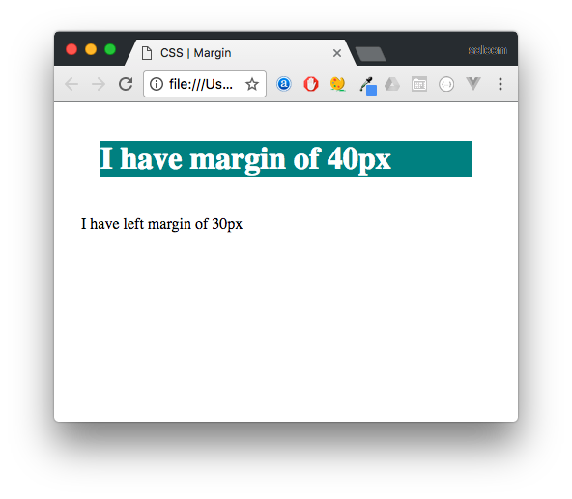
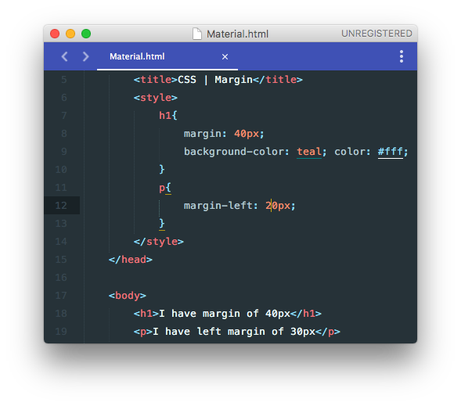
Margin
The CSS margin properties are used to
generate space around elements.
It can be user to center elements -> auto
Margin - Individual Sides
margin-top
margin-right
margin-bottom
margin-left

Slide 9

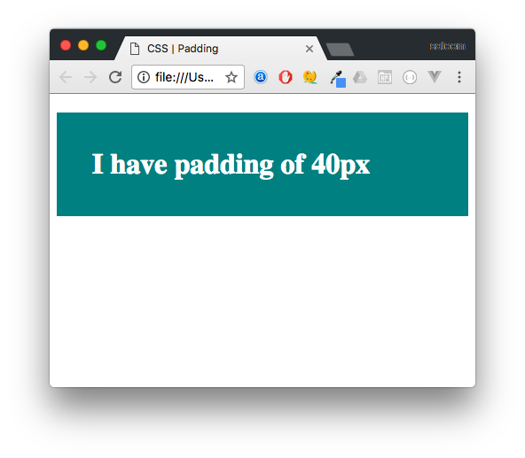
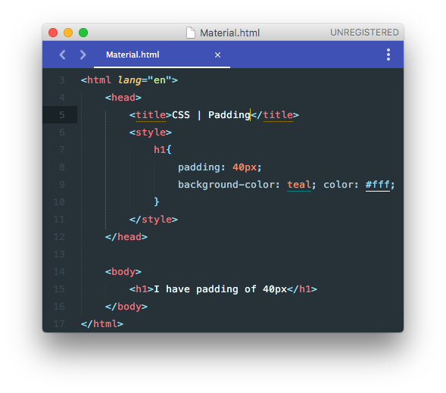
Padding
The CSS padding properties are used to
generate space around content.
Padding - Individual Sides
padding-top
padding-right
padding-bottom
padding-left

Slide 10
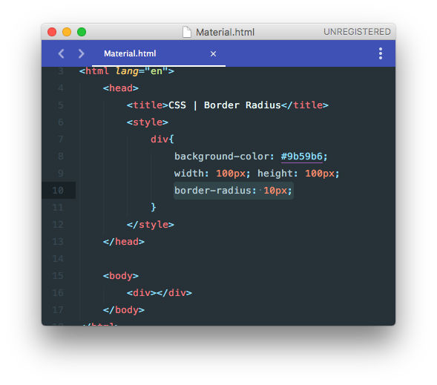
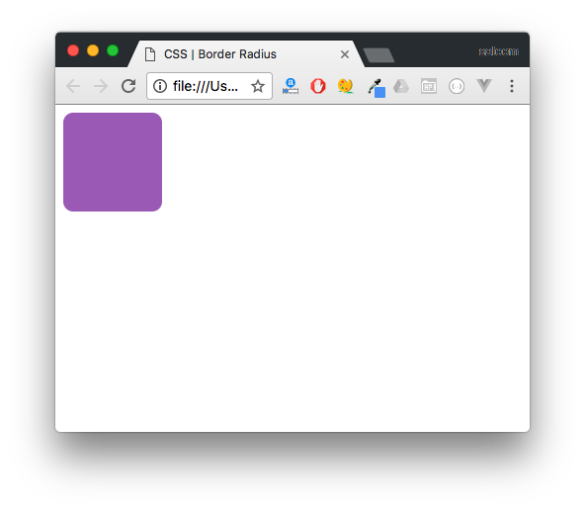
Border Radius

Slide 11
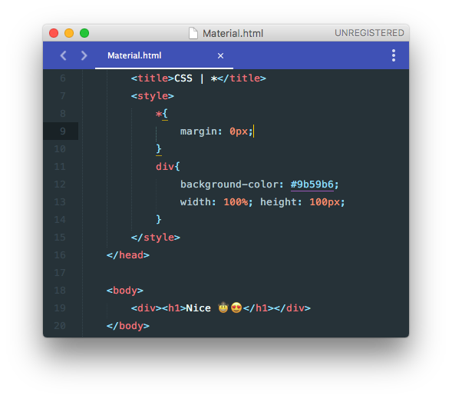
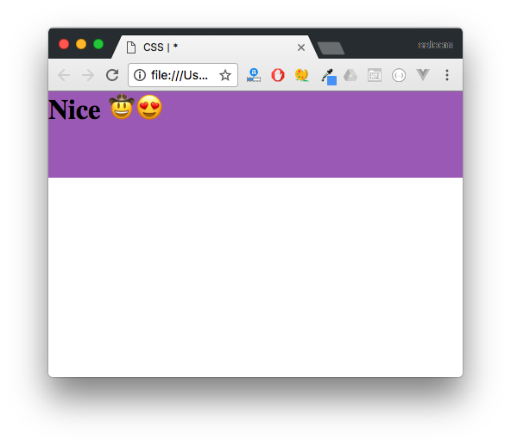
*
Everything
* Selector is very useful when you want to apply certain
CSS design on all the elements on the page.

Slide 12
Project 6

Slide 13

Classes VS IDs
Class
.
ID
#

Slide 14

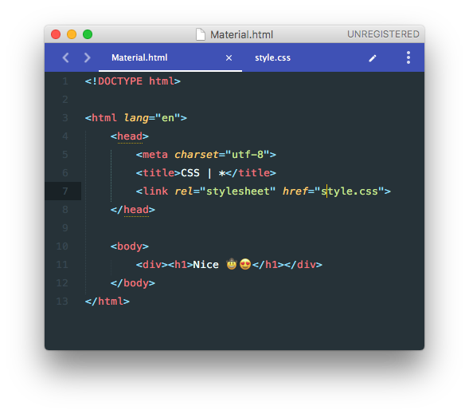

External CSS

Slide 15
Project 7

